Slide 1

Geometry
Unit 13, Lesson 8 Classifying Quadrilaterals – Part 1 Volume 2, pg. 327

Slide 2


Benchmark
MA.912.GR.3.2
Given a mathematical context, use coordinate geometry to classify or justify definitions, properties, and theorems involving circles, triangles, or quadrilaterals.
volume 2, pg. 327

Slide 3
Integrated Mathematical Thinking and Reasoning Standards
MA.K12.MTR.1.1 Actively participate in effortful learning both individually and collectively.
MA.K12.MTR.2.1 Demonstrate understanding by representing problems in multiple ways.
MA.K12.MTR.4.1 Engage in discussions that reflect on the mathematical thinking of self and others.
MA.K12.MTR.5.1 Use patterns and structure to help understand and connect mathematical concepts.
volume 2, pg. 327

Slide 4

Learning Targets
I can use coordinate geometry to classify quadrilaterals based on their properties in a mathematical or real-world context.
I can draw a quadrilateral on a coordinate plane using given definitions, properties, or theorems.
volume 2, pg. 327

Slide 5

Warm-Up
volume 2, pg. 327

Slide 6
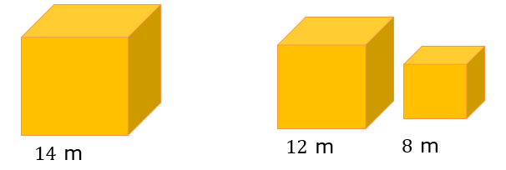

13.8.1 Warm-Up: Growth Mindset
Gold is worth a significant amount of money. Its value changes with the market. For example, on January 28, 2021 the value of $1$ ounce of gold was nearly $\$2000$.
Would you rather have one cube made of solid gold measuring $14$ meters (m) on each side, or two cubes made of solid gold, one measuring $12$ m on each side and one measuring $8$ m on each side?
Explain your choice.
volume 2, pg. 327

Slide 7

Exploration
volume 2, pg. 328

Slide 8
13.8.2 Exploration: Classifying Quadrilaterals Using Properties
Complete the table by filling in the blanks using the word bank. Words may be used more than once, or they may not be used.
volume 2, pg. 328

Slide 9
Word Bank
bisect(s) | congruent
parallel | perpendicular
Classification | Property
Parallelogram | Opposite sides are _____________ and _______________.
Parallelogram | Diagonals ____________ each other.
Rectangle | Diagonals are __________________.
Rhombus | Diagonals are __________________.
Square | Diagonals are ________________ and ___________________.
Kite | Exactly one diagonal _____________ the other, and diagonals are _________________.
Isosceles Trapezoid | Diagonals are ________________ and at least one pair of sides are ______________.
volume 2, pg. 328

Slide 10
Discuss with your partner if knowing two consecutive sides are congruent is sufficient to classify a quadrilateral. Summarize your discussion and justify your decision.
Discuss with your partner if knowing a pair of opposite sides are congruent is sufficient to classify the quadrilateral. Summarize your discussion and justify your decision.
volume 2, pg. 328

Slide 11
Complete the diagram using the different types of quadrilaterals. Each blue box is a subcategory of quadrilaterals. Each green box is a subcategory of the blue box that it is connected to.
Quadrilaterals
Isosceles Trapezoid
volume 2, pg. 328

Slide 12
Which quadrilateral was not included in the diagram?
Draw a box and any necessary arrows to include the missing quadrilateral in the diagram.
volume 2, pg. 328

Slide 13
Exploration
volume 2, pg. 329

Slide 14
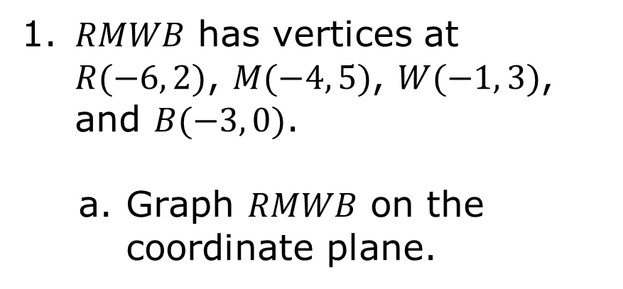
13.8.3 Exploration: Classifying Quadrilaterals
𝑅𝑀𝑊𝐵 has vertices at $R(−6, 2)$, $M(−4, 5)$, $W(−1, 3)$, and $B(−3, 0)$.
Graph 𝑅𝑀𝑊𝐵 on the coordinate plane.
volume 2, pg. 329

Slide 15
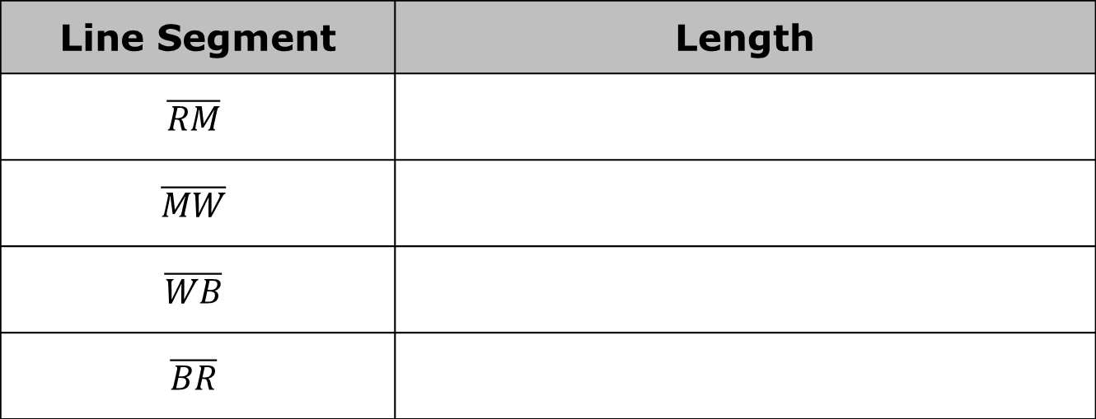
Complete the table.
Line Segment | Length
$$\overline{RM}$$
$$\overline{MW}$$
$$\overline{WB}$$
$$\overline{BR}$$
What do you notice about the side lengths of 𝑅𝑀𝑊𝐵?
volume 2, pg. 329

Slide 16
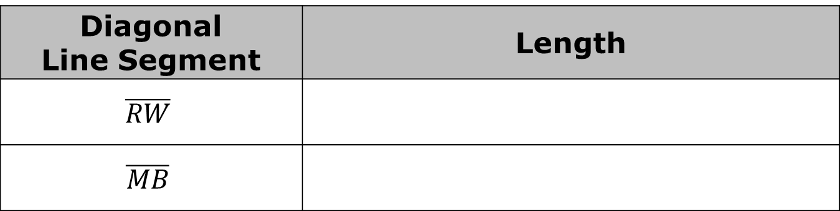
Select all of the classifications that apply to 𝑅𝑀𝑊𝐵.
Isosceles trapezoid
Kite
Parallelogram
Rectangle
Rhombus
Square
Trapezoid
Complete the table.
Diagonal Line Segment | Length
$$\overline{RW}$$
$$\overline{MB}$$
volume 2, pg. 329

Slide 17

What do you notice about the diagonal lengths of 𝑅𝑀𝑊𝐵?
Complete the statement.
Since 𝑅𝑀𝑊𝐵 congruent diagonals, 𝑅𝑀𝑊𝐵 is classified as a(n) __________________.
volume 2, pg. 330

Slide 18
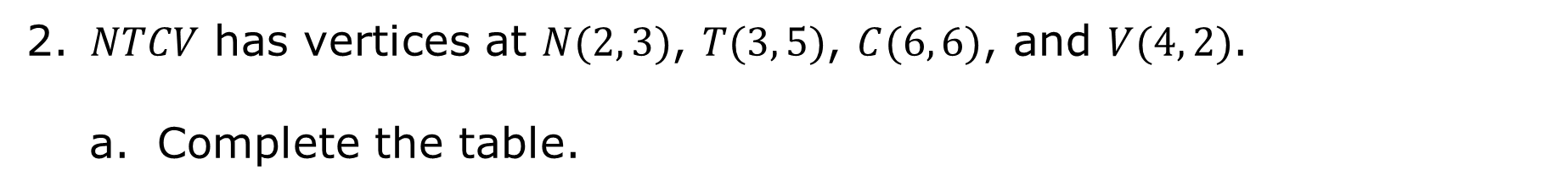
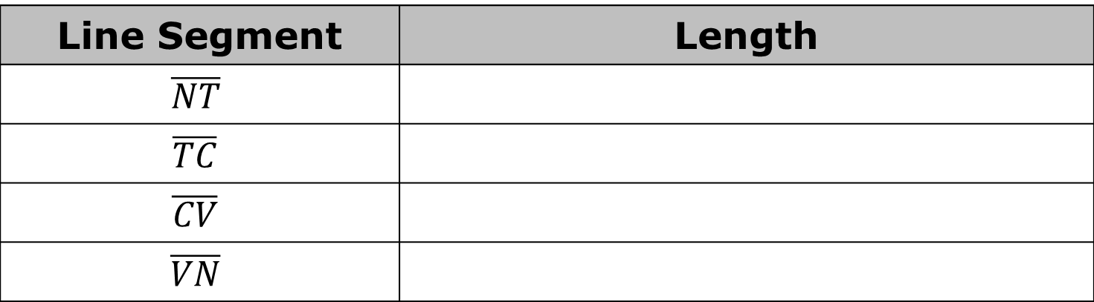
𝑁𝑇𝐶𝑉 has vertices at $N(2, 3)$, $T(3, 5)$, $C(6, 6)$, and $V(4, 2)$.
Complete the table.
Line Segment | Length
$$\overline{NT}$$
$$\overline{TC}$$
$$\overline{CV}$$
$$\overline{VN}$$
What do you notice about the side lengths of 𝑁𝑇𝐶𝑉?
volume 2, pg. 330

Slide 19
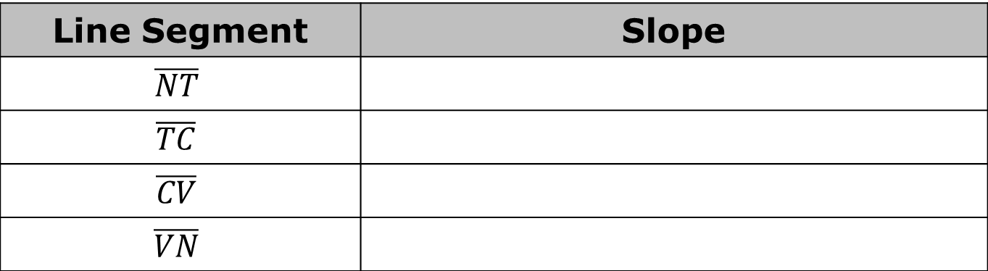
Complete the table.
Line Segment | Slope
$$\overline{NT}$$
$$\overline{TC}$$
$$\overline{CV}$$
$$\overline{VN}$$
What do you notice about the side slopes of 𝑁𝑇𝐶𝑉?
volume 2, pg. 330

Slide 20
Select all of the classifications that apply to 𝑁𝑇𝐶𝑉.
Isosceles trapezoid
Kite
Parallelogram
Rectangle
Rhombus
Square
Trapezoid
volume 2, pg. 330

Slide 21

Guided Practice
volume 2, pg. 331

Slide 22

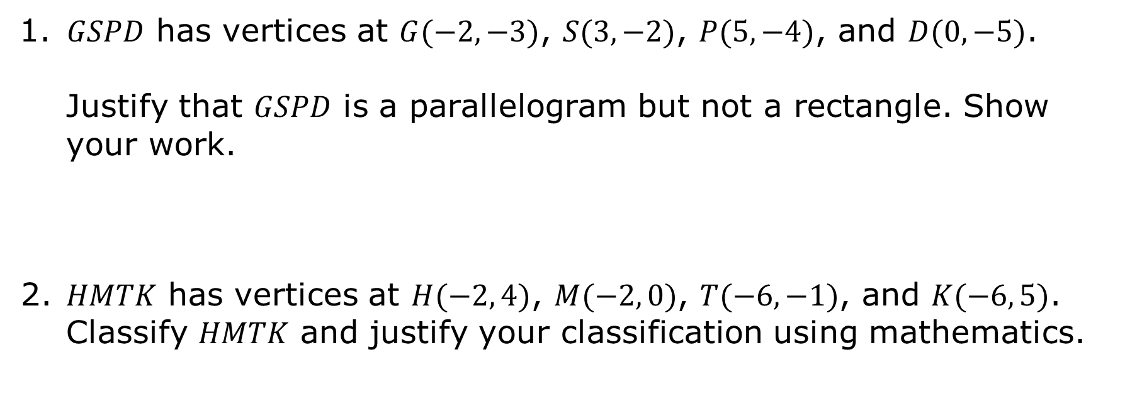
13.8.4 Guided Practice: Classifying Quadrilaterals
𝐺𝑆𝑃𝐷 has vertices at $G(−2,−3)$, $S(3,−2)$, $P(5,−4)$, and $D(0,−5)$.
Justify that 𝐺𝑆𝑃𝐷 is a parallelogram but not a rectangle. Show your work.
𝐻𝑀𝑇𝐾 has vertices at $H(−2, 4)$, $M(−2, 0)$, $T(−6,−1)$, and $K(−6, 5)$. Classify 𝐻𝑀𝑇𝐾 and justify your classification using mathematics.
volume 2, pg. 331

Slide 23
Use the coordinate grid to complete the following.
Draw a quadrilateral for which the side lengths are all equal, but the diagonals are not congruent.
volume 2, pg. 331

Slide 24
Complete the statement.
This quadrilateral is classified as a _______________.
Discuss with your partner how another classmate could use the coordinates of your quadrilateral to verify that your classification is correct. Summarize your discussion.
volume 2, pg. 331/332

Slide 25

Your Turn
volume 2, pg. 332

Slide 26
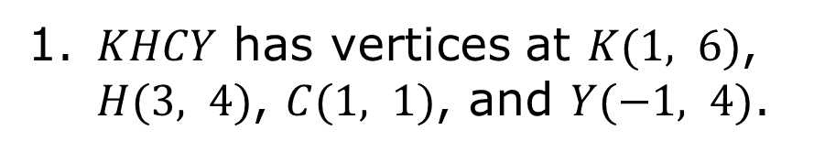
13.8.5 Your Turn!
𝐾𝐻𝐶𝑌 has vertices at $K(1, 6)$, $H(3, 4)$, $C(1, 1)$, and $Y(−1, 4)$.
𝐾𝐻𝐶𝑌 is classified as a __________ because …
volume 2, pg. 332

Slide 27
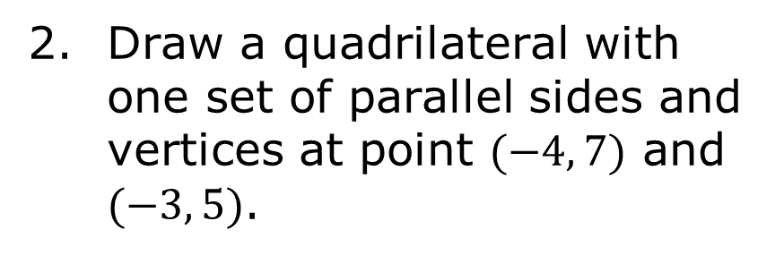
Draw a quadrilateral with one set of parallel sides and vertices at point $(−4, 7)$ and $(−3, 5)$.
This quadrilateral is classified as a ____________ because …
volume 2, pg. 333

Slide 28

Wrap-Up
volume 2, pg. 333

Slide 29
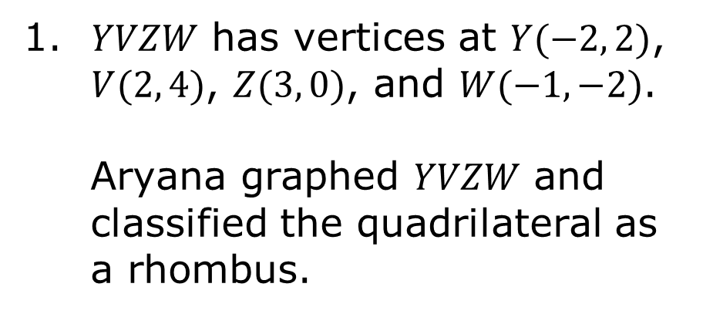
13.8.6 Wrap-Up: Error Analysis
𝑌𝑉𝑍𝑊 has vertices at $Y(−2, 2)$, $V(2, 4)$, $Z(3, 0)$, and $W(−1,−2)$.
Aryana graphed 𝑌𝑉𝑍𝑊 and classified the quadrilateral as a rhombus.
volume 2, pg. 333

Slide 30
Do you agree with Aryana?
Justify your answer using properties and showing your work.
volume 2, pg. 333

